Slide 1
Relation Extraction
Slides from http://web.stanford.edu/~jurafsky/slp3/ Some of this material is also available on coursera

Slide 2
What is knowledge acquisition?
Knowledge acquisition: process to extract knowledge (to be integrated into knowledge bases) from unstructured text or other data
Raw Text
(HTML pages, etc)
Refined Text
Textual Entities and Relations
Knowledge Bases
Identify relations

Slide 3
Extracting Relations From Text
Company report: “International Business Machines Corporation (IBM or the company) was incorporated in the State of New York on June 16, 1911, as the Computing-Tabulating-Recording Co. (C-T-R)…”
Extracted Complex Relation:
Company-Founding
Company IBM
Location New York
Date June 16, 1911
But we will focus on the simpler task of extracting relation triples
Founding-year(IBM,1911)
Founding-location(IBM,New York)

Slide 4
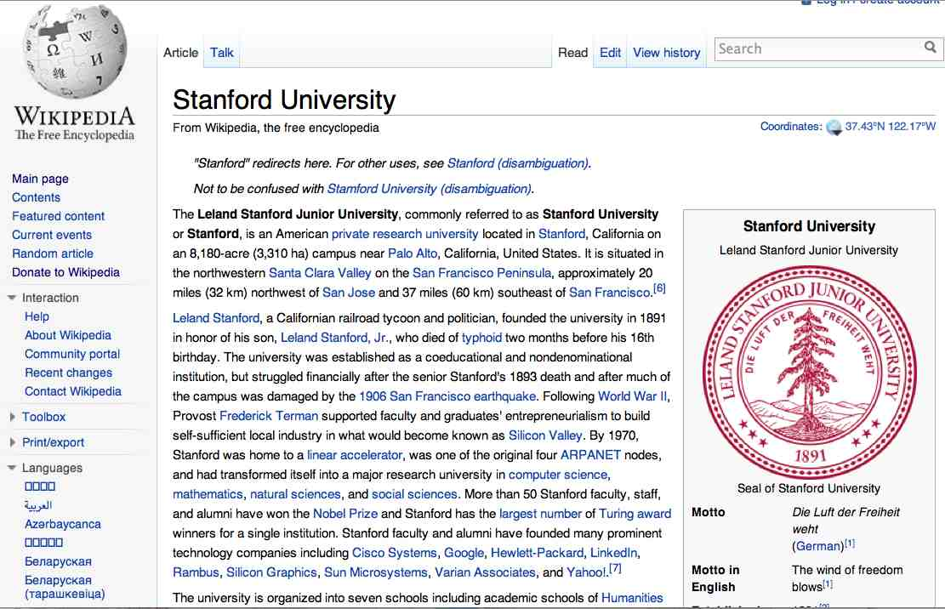
Extracting Relation Triples from Text
The Leland Stanford Junior University, commonly referred to as Stanford University or Stanford, is an American private research university located in Stanford, California … near Palo Alto, California… Leland Stanford…founded the university in 1891
Stanford EQ Leland Stanford Junior University
Stanford LOC-IN California
Stanford IS-A research university
Stanford LOC-NEAR Palo Alto
Stanford FOUNDED-IN 1891
Stanford FOUNDER Leland Stanford

Slide 5
Why Relation Extraction?
First step to knowledge acquisition
Adding words to WordNet thesaurus, facts to FreeBase or DBPedia
Support question answering
The granddaughter of which actor starred in the movie “E.T.”?
(acted-in ?x “E.T.”)(is-a ?y actor)(granddaughter-of ?x ?y)
But which relations should we extract?

Slide 6

Some History…
Initially, knowledge bases were manually constructed
WordNet
CYC
Started in 1984 by Douglas Lenat at MCC
Goal: Codify in machine-readable form millions of pieces of knowledge that compose human common sense
Still ongoing. Opensource version is called opencyc

Slide 7
Types of Relation Extraction
It’s hard to enrich knowledge bases manually. How can we do it automatically?
Traditional Extraction: start from a set of known relations, and annotated input
Open Extraction: extract relations without any prior information
[1] M. Banko, O. Etzioni, and T. Center, “The Tradeoffs Between Open and Traditional Relation Extraction.,” in ACL, 2008, vol. 8, pp. 28–36.

Slide 8
Traditional Extraction

Slide 9
Automated Content Extraction (ACE)
Automatic Content Extraction (ACE) is a research program for developing advanced information extraction convened by the NIST from 1999 to 2008 [1]
Challenge of the program was to detect
Entities mentioned in the text, such as: persons, organizations, locations, etc.
Relations between entities
Events such as interactions, etc.
The ACE corpus is one of the standard benchmarks for testing new information extraction algorithms
[1] G. R. Doddington, A. Mitchell, M. A. Przybocki, L. A. Ramshaw, S. Strassel, and R. M. Weischedel, “The Automatic Content Extraction (ACE) Program-Tasks, Data, and Evaluation.,” in LREC, 2004, vol. 2, p. 1.

Slide 10
Automated Content Extraction (ACE)
17 relations from 2008 “Relation Extraction Task”

Slide 11
Automated Content Extraction (ACE)
Physical-Located PER-GPE
He was in Tennessee
Part-Whole-Subsidiary ORG-ORG
XYZ, the parent company of ABC
Person-Social-Family PER-PER
John’s wife Yoko
Org-AFF-Founder PER-ORG
Steve Jobs, co-founder of Apple…

Slide 12
UMLS: Unified Medical Language System
Specific to the medical domain, defines 134 entity types, 54 relations
Injury disrupts Physiological Function
Bodily Location location-of Biologic Function
Anatomical Structure part-of Organism
Pharmacologic Substance causes Pathological Function
Pharmacologic Substance treats Pathologic Function

Slide 13
Extracting UMLS relations from a sentence
Doppler echocardiography can be used to diagnose left anterior descending artery stenosis in patients with type 2 diabetes
⬇
Echocardiography, Doppler DIAGNOSES Acquired stenosis

Slide 14
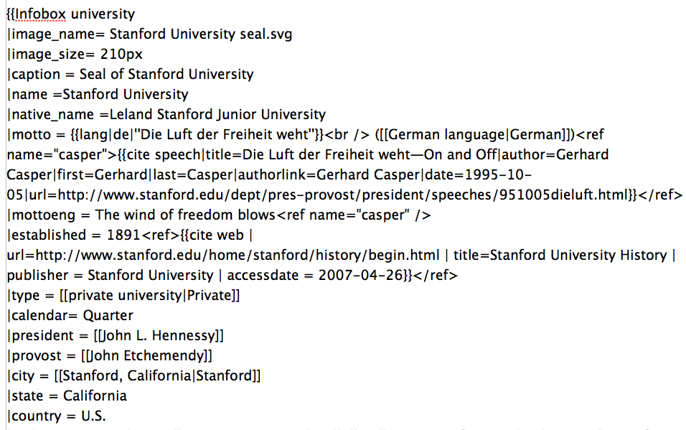
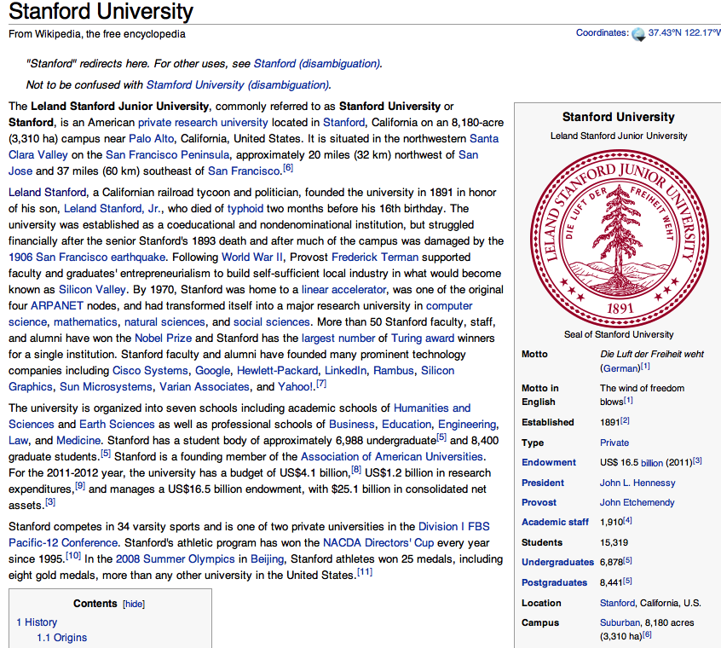
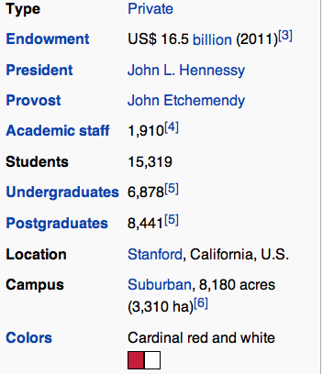
Databases of Wikipedia Relations
Wikipedia Infobox
Relations extracted from Infobox
Stanford state California
Stanford motto “Die Luft der Freiheit weht”
…

Slide 15
Ontological relations
Examples from the WordNet Thesaurus
IS-A (hypernym): subsumption between classes
Giraffe IS-A ruminant IS-A ungulate IS-A mammal IS-A vertebrate IS-A animal…
Instance-of: relation between individual and class
San Francisco instance-of city

Slide 16
Types of traditional relational extraction methods
Hand-written patterns
Supervised machine learning
Semi-supervised
Bootstrapping (using seeds)
Distant supervision

Slide 17
Types of traditional relational extraction methods
Hand-written patterns
Supervised machine learning
Semi-supervised
Bootstrapping (using seeds)
Distant supervision

Slide 18
Rules for extracting IS-A relation
Early intuition from Hearst (1992) [1]
“Agar is a substance prepared from a mixture of red algae, such as Gelidium, for laboratory or industrial use”
What does Gelidium mean?
How do you know?
[1] M. A. Hearst, “Automatic acquisition of hyponyms from large text corpora,” in Proceedings of the 14th conference on Computational linguistics-Volume 2, 1992, pp. 539–545.

Slide 19
Rules for extracting IS-A relation
Early intuition from Hearst (1992) [1]
“Agar is a substance prepared from a mixture of red algae, such as Gelidium, for laboratory or industrial use”
What does Gelidium mean?
How do you know?`
[1] M. A. Hearst, “Automatic acquisition of hyponyms from large text corpora,” in Proceedings of the 14th conference on Computational linguistics-Volume 2, 1992, pp. 539–545.

Slide 20
Hearst’s Patterns for extracting IS-A relations
Automatic Acquisition of Hyponyms
“Y such as X ((, X)* (, and|or) X)”
“such Y as X”
“X or other Y”
“X and other Y”
“Y including X”
“Y, especially X”

Slide 21
Hearst’s Patterns for extracting IS-A relations
Hearst pattern | Example occurrences
X and other Y | ...temples, treasuries, and other important civic buildings.
X or other Y | Bruises, wounds, broken bones or other injuries...
Y such as X | The bow lute, such as the Bambara ndang...
Such Y as X | ...such authors as Herrick, Goldsmith, and Shakespeare.
Y including X | ...common-law countries, including Canada and England...
Y , especially X | European countries, especially France, England, and Spain...

Slide 22
Extracting Richer Relations Using Rules
Intuition: relations often hold between specific entities
located-in (ORGANIZATION, LOCATION)
founded (PERSON, ORGANIZATION)
cures (DRUG, DISEASE)
Start with Named Entity tags to help extract relation!

Slide 23


Named Entities aren’t quite enough. Which relations hold between 2 entities?
Cure?
Prevent?
Drug
Cause?
Disease
Notes:
Drug and disease pictures from Wikimedia Commons
http://commons.wikimedia.org/wiki/File:Gnome-face-sick.svg

Slide 24
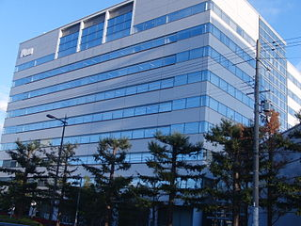

What relations hold between 2 entities?
Founder?
Investor?
Member?
PERSON
ORGANIZATION
Employee?
President?
Notes:
pictures from Wikimedia Commons
http://upload.wikimedia.org/wikipedia/commons/thumb/9/9a/Sanyo_Electric_Corporation.JPG/320px-Sanyo_Electric_Corporation.JPG

Slide 25
Extracting Richer Relations Using Rules and Named Entities
Who holds what office in what organization?
PERSON, POSITION of ORG
George Marshall, Secretary of State of the United States
PERSON(named|appointed|chose|etc.) PERSON Prep? POSITION
Truman appointed Marshall Secretary of State
PERSON [be]? (named|appointed|etc.) Prep? ORG POSITION
George Marshall was named US Secretary of State

Slide 26
Hand-built Patterns
Plus:
Human patterns tend to be high-precision
Can be tailored to specific domains
Minus
Human patterns are often low-recall
A lot of work to think of all possible patterns!
Don’t want to have to do this for every relation!
We’d like better accuracy

Slide 27
Types of traditional relational extraction methods
Hand-written patterns
Supervised machine learning
Semi-supervised
Bootstrapping (using seeds)
Distant supervision

Slide 28
Supervised machine learning for relations
Choose a set of relations we’d like to extract (e.g. ACE, UMLS)
Choose a set of relevant named entities
Find and label data
Choose a representative corpus
Label the named entities in the corpus
Hand-label the relations between these entities
Break into training, development, and test
Train a classifier on the training set

Slide 29
Choose a set of relations we’d like to extract
17 sub-relations of 6 relations from 2008 “Relation Extraction Task”

Slide 30
Find and Label Data
Find all pairs of named entities
Decide if 2 entities are related
If yes, classify the relation
Why the extra step?
Faster classification training by eliminating most pairs
Can use distinct feature-sets appropriate for each task

Slide 31

Find and Label Data
Classify the relation between two entities in a sentence
American Airlines, a unit of AMR, immediately matched the move, spokesman Tim Wagner said.
EMPLOYMENT
FAMILY
NIL
CITIZEN
…
INVENTOR
SUBSIDIARY
FOUNDER

Slide 32
Common Word Features for Classifier
American Airlines, a unit of AMR, immediately matched the move, spokesman Tim Wagner said
Mention 1
Mention 2
Headwords of M1 and M2, and combination
Airlines Wagner Airlines-Wagner
Bag of words and bigrams in M1 and M2
{American, Airlines, Tim, Wagner, American Airlines, Tim Wagner}
Words or bigrams in particular positions left and right of M1/M2
M2: -1 spokesman
M2: +1 said
Bag of words or bigrams between the two entities
{a, AMR, of, immediately, matched, move, spokesman, the, unit}

Slide 33
Common Word Features for Classifier
American Airlines, a unit of AMR, immediately matched the move, spokesman Tim Wagner said
Mention 1
Mention 2
Named-entity types
M1: ORG
M2: PERSON
Concatenation of the two named-entity types
ORG-PERSON
Entity Level of M1 and M2 (NAME, NOMINAL, PRONOUN)
M1: NAME [it or he would be PRONOUN]
M2: NAME [the company would be NOMINAL]

Slide 34
Parse Features for Relation Extraction
American Airlines, a unit of AMR, immediately matched the move, spokesman Tim Wagner said
Mention 1
Mention 2
Constituent path through the tree from one to the other
NP ⬆ NP ⬆ S ⬇ NP

Slide 35
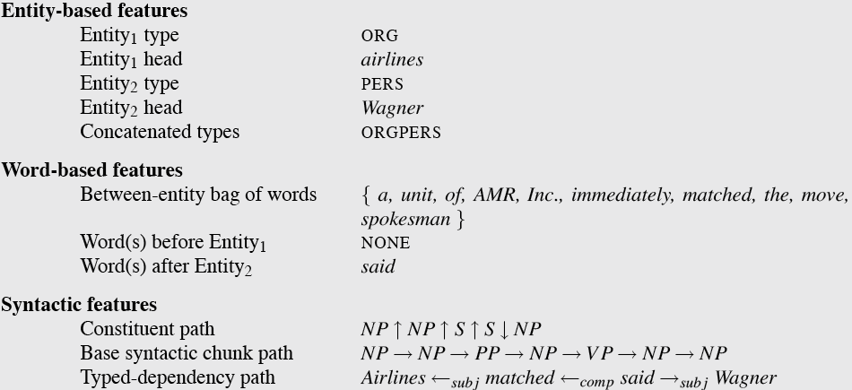
American Airlines, a unit of AMR, immediately matched the move, spokesman Tim Wagner said.

Slide 36
Classifiers for supervised methods
Now you can use any classifier you like
Max Entropy
Naïve Bayes
SVM
...
Train it on the training set, tune on the dev set, test on the test set

Slide 37
Summary: Supervised Relation Extraction
+ Can get high accuracies with enough hand-labeled training data, if test similar enough to training
- Labeling a large training set is expensive
- Supervised models are brittle, don’t generalize well to different genres

Slide 38
Types of traditional relational extraction methods
Hand-written patterns
Supervised machine learning
Semi-supervised
Bootstrapping (using seeds)
Distant supervision

Slide 39
Relation Bootstrapping
Supervised methods assume you have a (large) training set that is available
No training set? Maybe you have
A few seed tuples or
A few high-precision patterns
Can you use those seeds to do something useful?
Bootstrapping: use the seeds to directly learn to populate a relation

Slide 40
Relation Bootstrapping
Gather a set of seed pairs that have relation R
Iterate:
Find sentences with these pairs
Look at the context between or around the pair and generalize the context to create patterns
Use the patterns for grep for more pairs

Slide 41
Bootstrapping
<Mark Twain, Elmira> Seed tuple
Grep (google) for the environments of the seed tuple
“Mark Twain is buried in Elmira, NY.”
X is buried in Y
“The grave of Mark Twain is in Elmira”
The grave of X is in Y
“Elmira is Mark Twain’s final resting place”
Y is X’s final resting place.
Use those patterns to grep for new tuples
Iterate

Slide 42
DIPRE [1]: Extract <author,book> pairs
Start with 5 seeds:
Find Instances:
The Comedy of Errors, by William Shakespeare, was
The Comedy of Errors, by William Shakespeare, is
The Comedy of Errors, one of William Shakespeare's earliest attempts
The Comedy of Errors, one of William Shakespeare's most
Extract patterns (group by middle, take longest common prefix/suffix)
?x , by ?y , ?x , one of ?y ‘s
Now iterate, finding new seeds that match the pattern
Author | Book
Isaac Asimov | The Robots of Dawn
David Brin | Startide Rising
James Gleick | Chaos: Making a New Science
Charles Dickens | Great Expectations
William Shakespeare | The Comedy of Errors
[1] S. Brin, “Extracting patterns and relations from the world wide web,” in International Workshop on The World Wide Web and Databases, 1998, pp. 172–183.

Slide 43
Snowball [1]
Inspired by DIPRE. Similar iterative algorithm
Group instances w/similar prefix, middle, suffix, extract patterns
But require that X and Y be named entities (DIPRE did not do this)
And compute a confidence for each pattern
Organization | Location of Headquarters
Microsoft | Redmond
Exxon | Irving
IBM | Armonk
.69
ORGANIZATION
{’s, in, headquarters}
LOCATION
.75
LOCATION
{in, based}
ORGANIZATION
[1] E. Agichtein and L. Gravano, “Snowball: Extracting relations from large plain-text collections,” in Proceedings of the fifth ACM conference on Digital libraries, 2000, pp. 85–94.

Slide 44
Snowball
Example of calculation of a pattern’s confidence
P=<{},ORGANIZATION, <“,”,1>, LOCATION,{}>
P.positive = “Exxon, Invine said”; “Intel, Santa Clara cut prices”
P.negative = “invest in Microsoft, New York-based analyst Jane Smith said”

Slide 45
Distant Supervision [1]
Combine bootstrapping with supervised learning
Instead of few seeds,
Use a large database to get huge # of seed examples
Create lots of features from all these examples
Combine in a supervised classifier
[1] M. Mintz, S. Bills, R. Snow, and D. Jurafsky, “Distant supervision for relation extraction without labeled data,” in Proceedings of the Joint Conference of the 47th Annual Meeting of the ACL and the 4th International Joint Conference on Natural Language Processing of the AFNLP: Volume 2-Volume 2, 2009, pp. 1003–1011.

Slide 46
Distant Supervision Paradigm
Like supervised classification:
Uses a classifier with lots of features
Supervised by detailed hand-created knowledge
Doesn’t require iteratively expanding patterns
Like unsupervised classification:
Uses very large amounts of unlabeled data
Not sensitive to genre issues in training corpus

Slide 47
Distantly supervised learning of relation extraction patterns
1
For each relation
For each tuple in big database
Find sentences in large corpus with both entities
Extract frequent features (parse, words, etc)
Train supervised classifier using thousands of patterns
Born-In
<Edwin Hubble, Marshfield>
<Albert Einstein, Ulm>
2
3
Hubble was born in Marshfield
Einstein, born (1879), Ulm
Hubble’s birthplace in Marshfield
4
PER was born in LOC
PER, born (XXXX), LOC
PER’s birthplace in LOC
5
P(born-in | f₁,f₂,f₃,…,f₇₀₀₀₀)

Slide 48
Possible exam questions
Name two well-known relation vocabularies
Do I always need seed tuples for bootstrapping?
Describe three scenarios where the DIPRE approach might not work
Name one condition that must hold in order to calculate the confidence of a pattern

